Slide 1




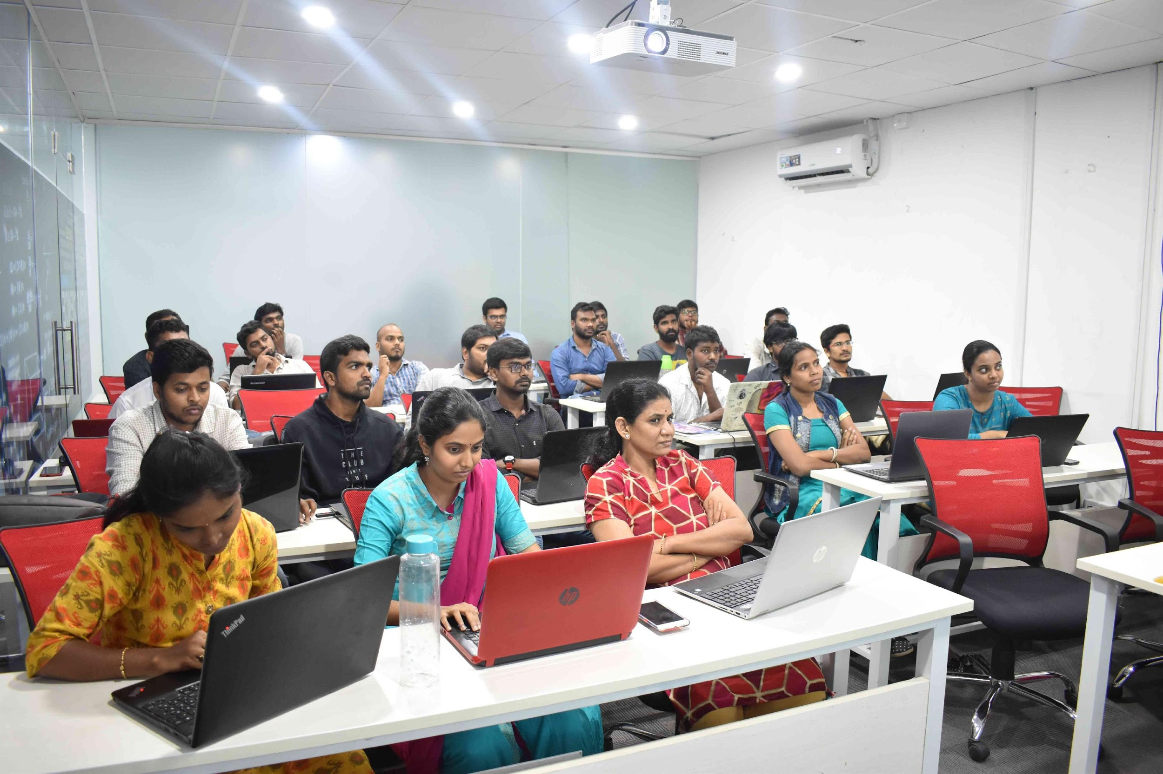



Slide 2
Plant Leaf Disease Detection

Slide 3
MAIN PURPOSE OF PROJECT:
This project is about collecting images of various infected, good and seemingly infected plant leafs. Then apply image processing on the images and predict the infected plant leaf’s using Deep Learning + Image Processing.
The main purpose is detect the diseased part of the leaf. Using python, Convolutional neural network are implemented in order to classify the diseased part. Aim is to detect the diseased part by finding the optimum way with minimum cost.

Slide 4
Libraries Required:
Tensorflow
Keras
Jupyter notebook
Scikit learn
Pickle
OpenCV

Slide 5
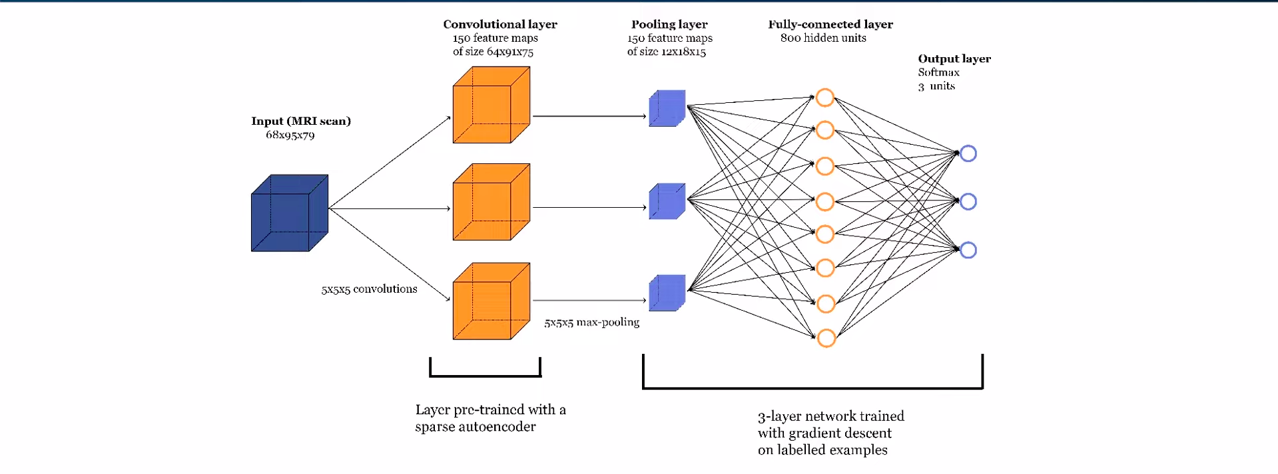
WORKFLOW

Slide 6
Dataset used in project:
We used dataset from kaggle. i.e. New Plant Diseases Dataset (Image dataset containing different healthy and unhealthy crop leaves).
This dataset is recreated using offline augmentation from the original dataset.
This dataset consists of about 87K RGB images of healthy and diseased crop leaves which is categorized into 38 different classes.
The total dataset is divided into 80/20 ratio of training and validation set preserving the directory structure. A new directory containing 33 test images is created later for prediction purpose.

Slide 7
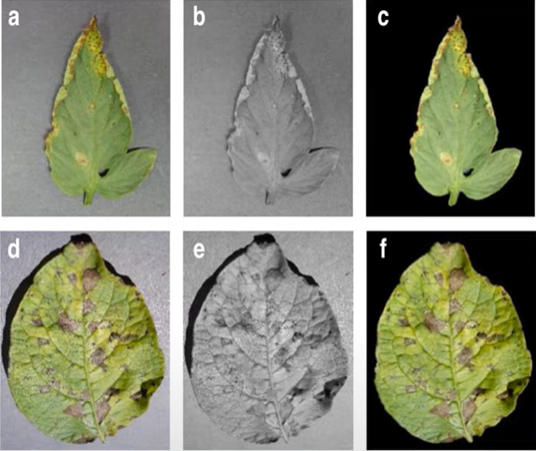
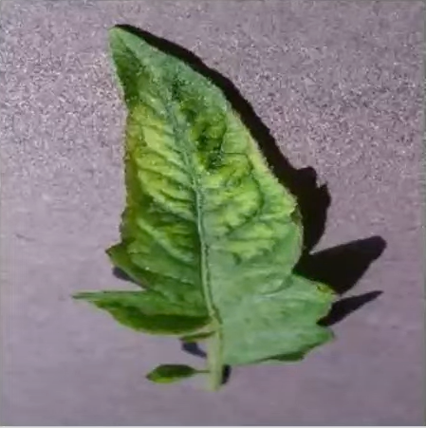
Images From Dataset:

Slide 8
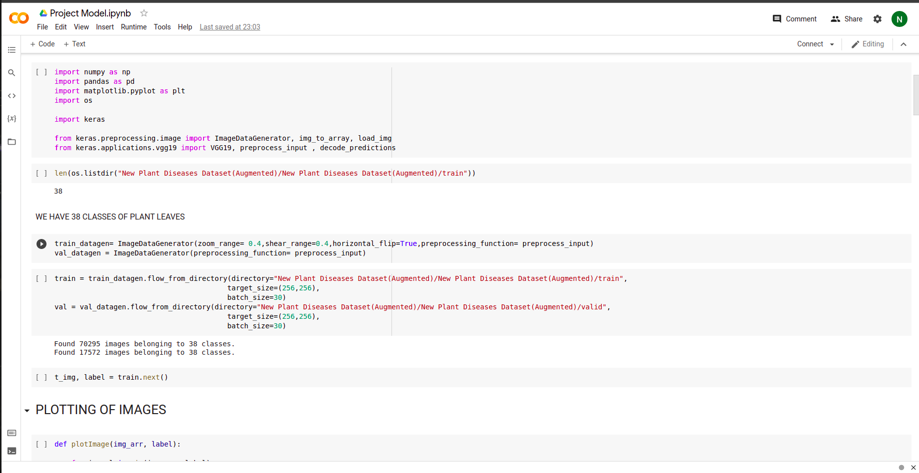
PREPROCESSING

Slide 9
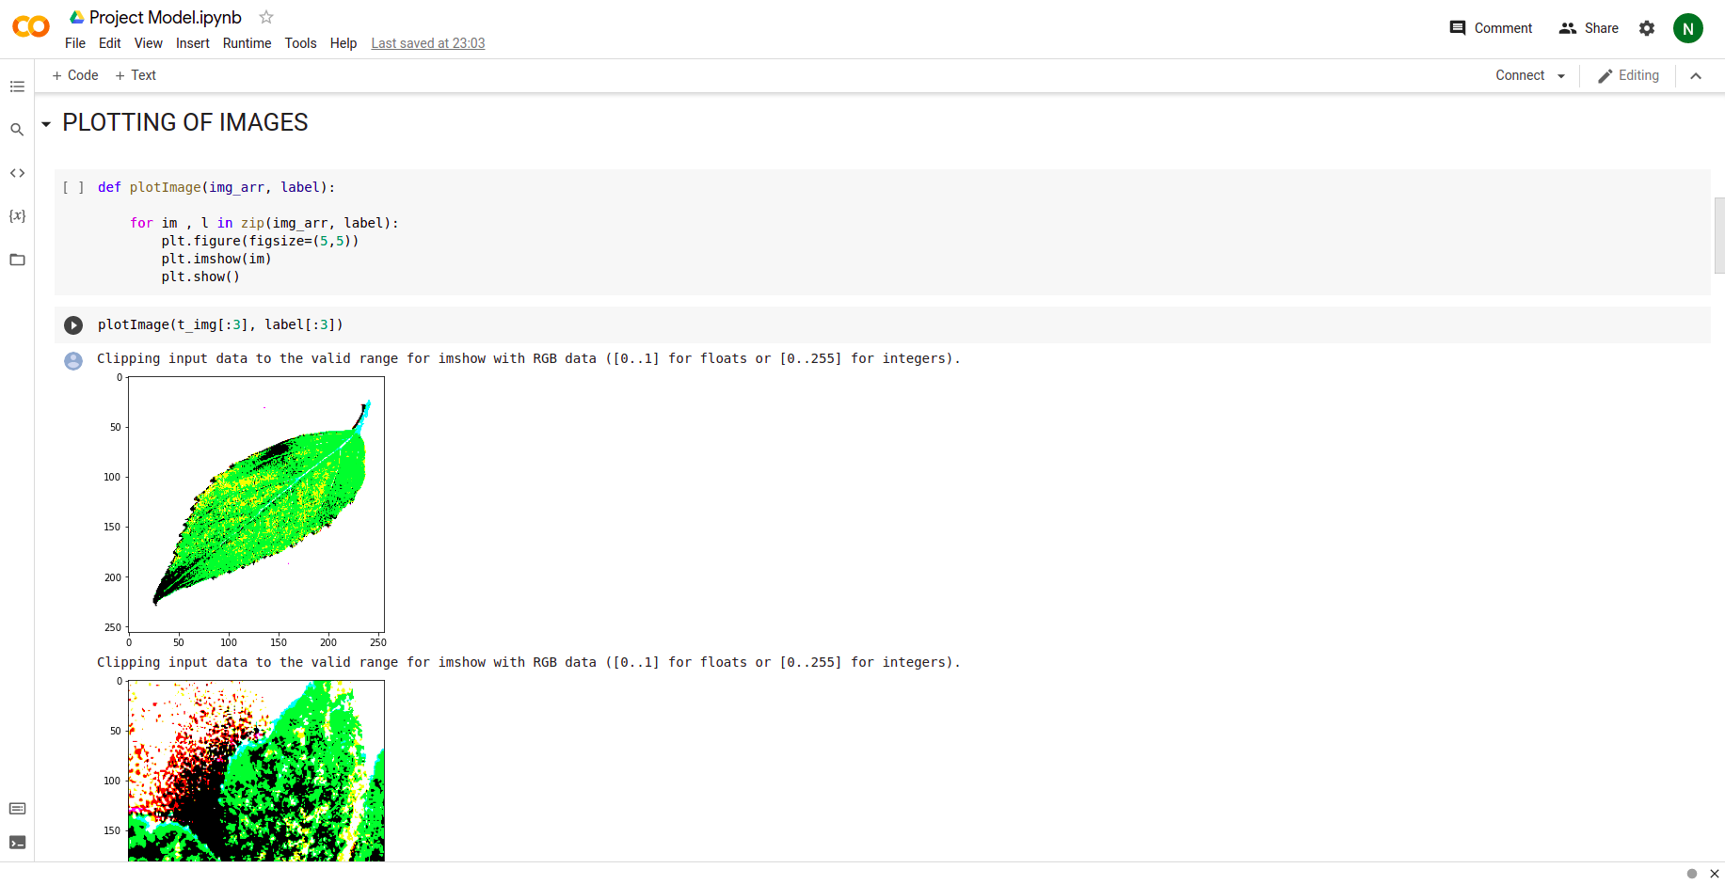

Slide 10
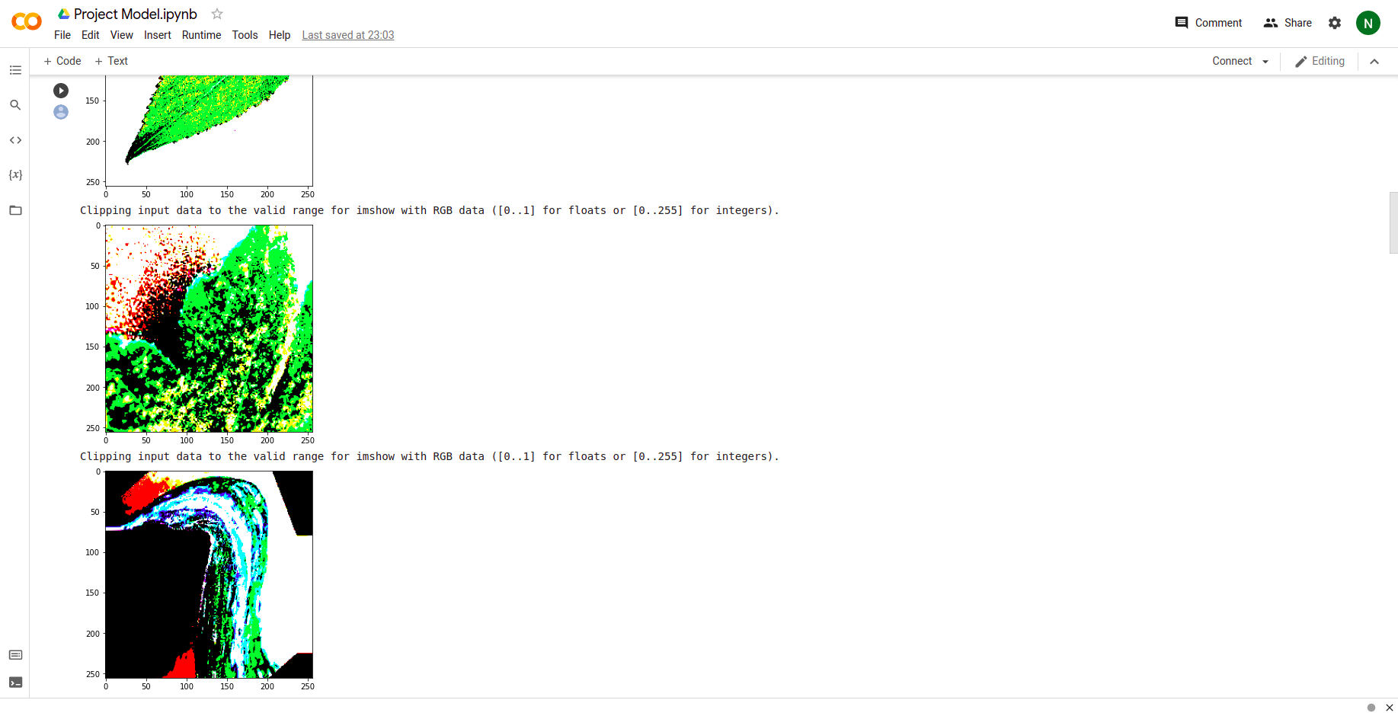

Slide 11
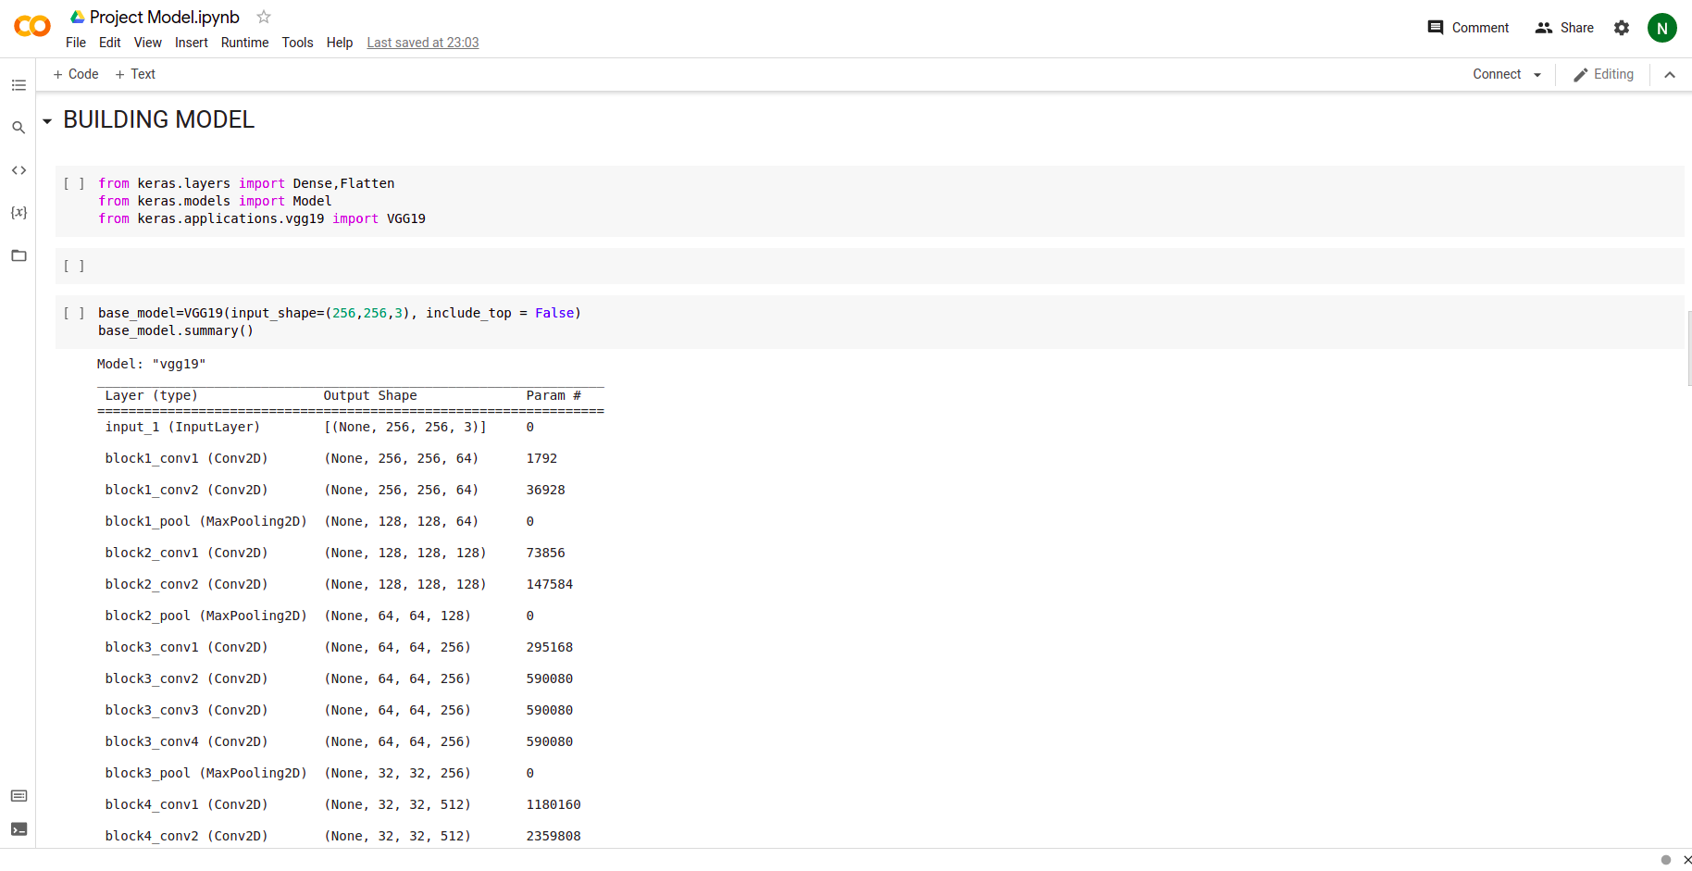
BUILDING MODEL

Slide 12
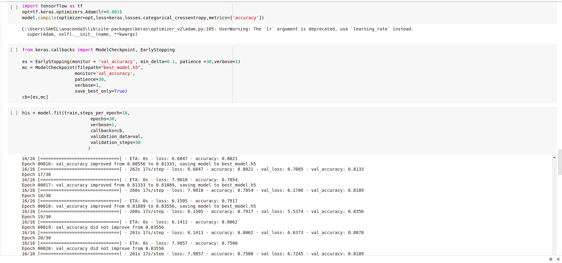
Early stopping and Model Check point

Slide 13
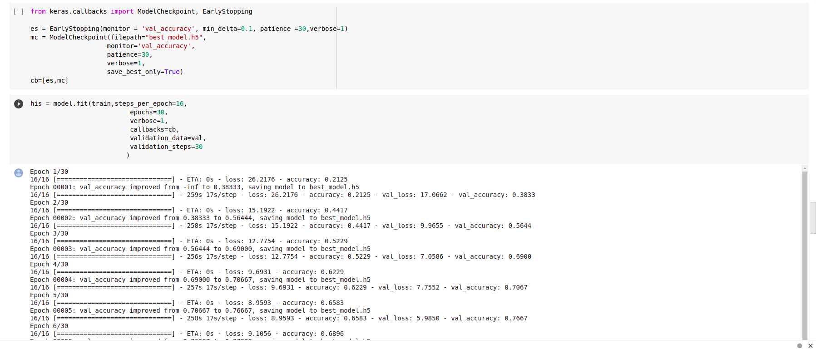
Model Training

Slide 14
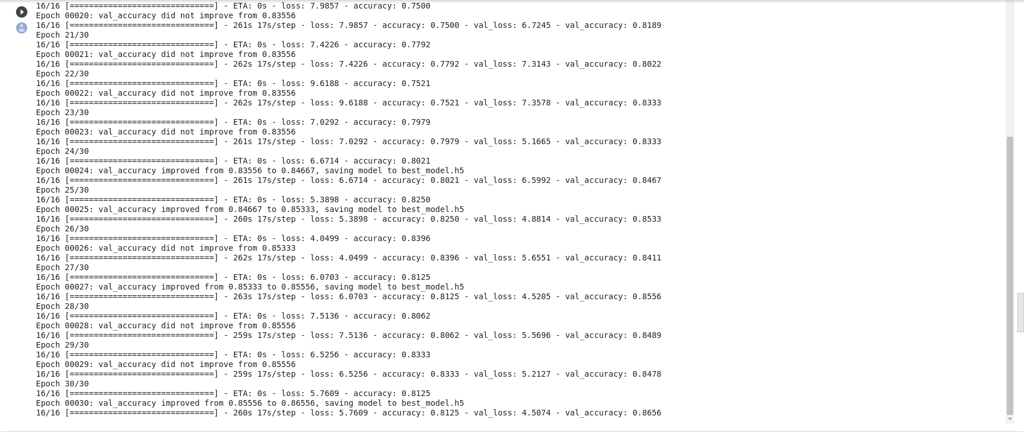

Slide 15
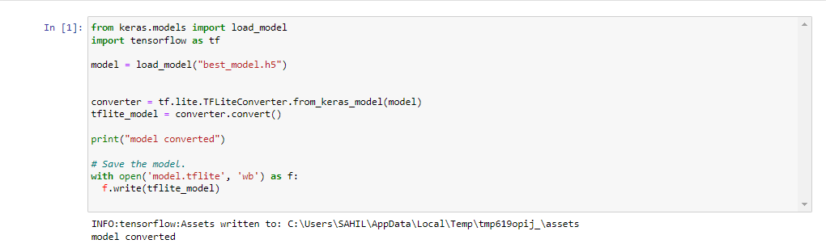
CONVERT OUR MODEL TO TFLITE

Slide 16
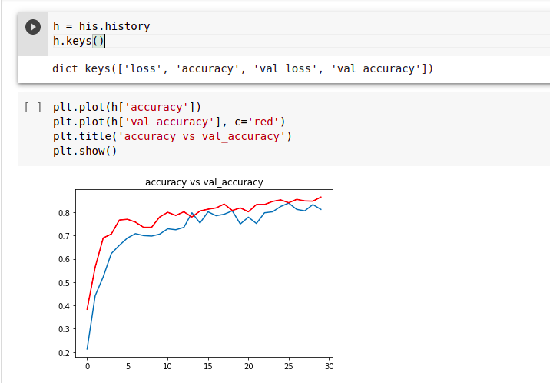
ACCURACY VS VALIDATION ACCURACY
The gap between accuracy and validation accuracy is not high.

Slide 17
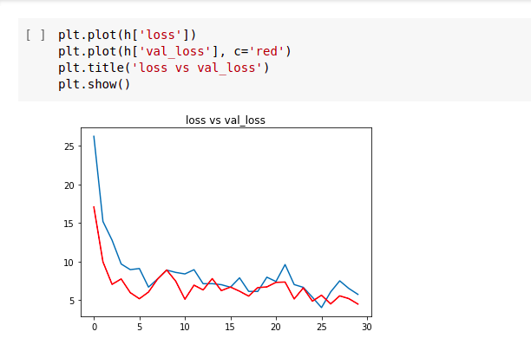
LOSS VS VALIDATION LOSS
Also the gap between the loss and validation loss is narrow too.

Slide 18
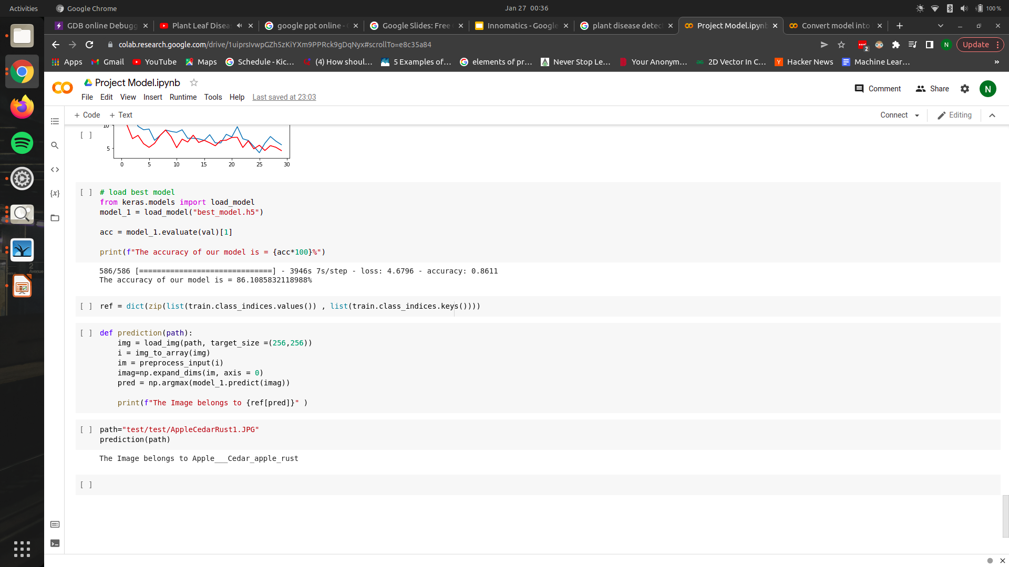
RESULT

Slide 19
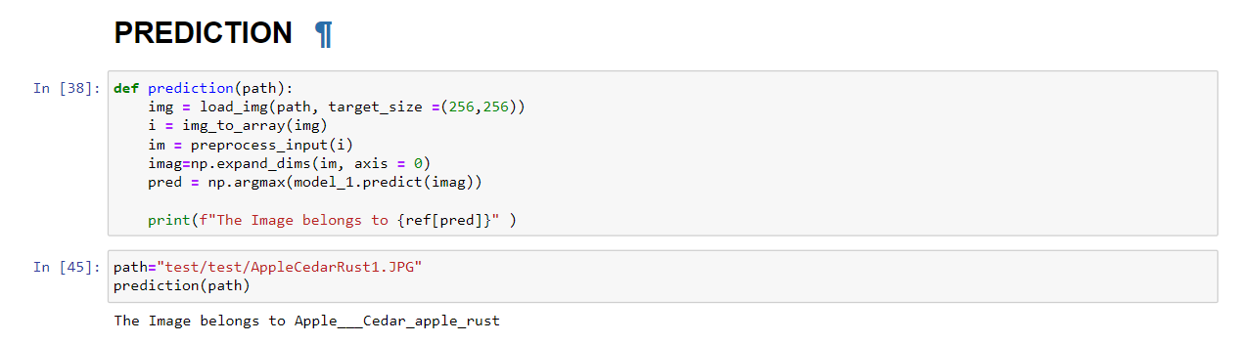
OUTPUT

Slide 20
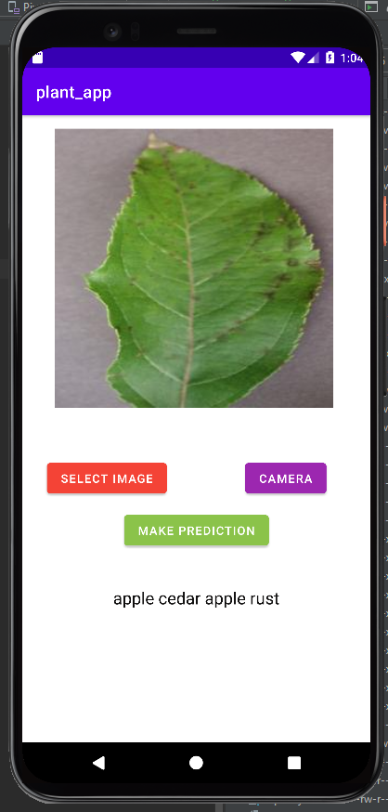
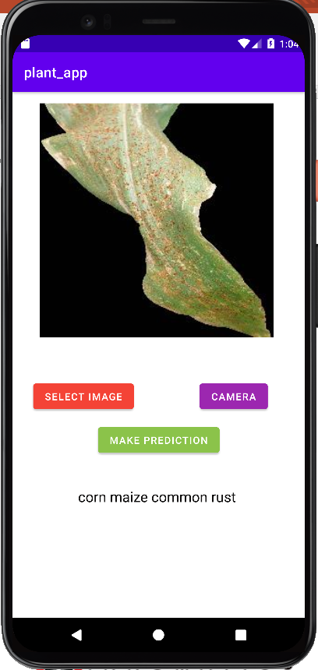
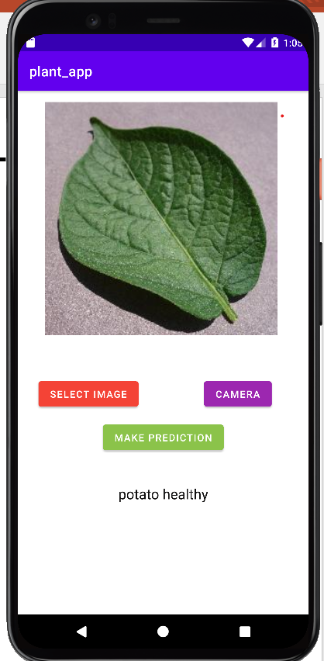
APPLICATION DEMONSTRATION

Slide 21

THANK YOU

